Slide 1




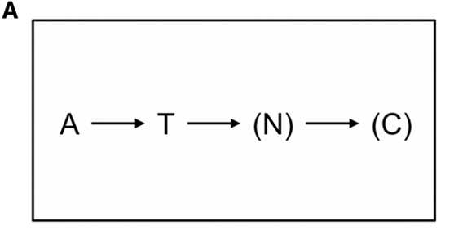
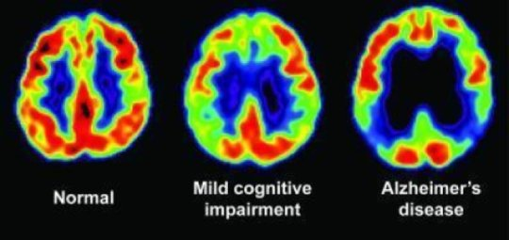
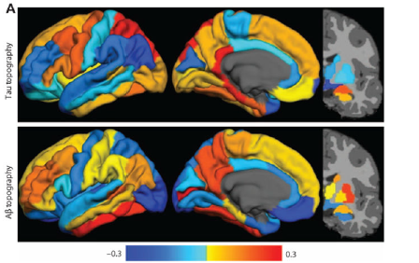
https://www.judahavenue.com
The CVOE Assessment: A Potential Novel Non-Invasive Neurocognitive Detector of
Preclinical Alzheimer's
Nicholas P. Maxwell¹, MS, Mark. J. Huff¹, PhD, Ronald Schwartz², MD, CPI, Cheryl Obiadi³, BA ¹ The University of Southern Mississippi, ² Hattiesburg Clinic, ³ William Carey University
(Masters in Biomedical Science)
Abstract
Methods
Conclusion
Alzheimer’s disease (AD) is characterized by a gradual breakdown in cognition such as disruptions to attentional control, memory, decision making, and impulse control Coimbra et al (2018) Given these deleterious changes, researchers have been interested in developing measures to detect early AD pathology that may be present well in advance of clinical symptoms, Bachunin et al. (2017) Recent models suggest that AD pathology may be present years or even decades prior to cognitive declines (e.g., Jack et al., 2018), however, most cognitive assessments used to support these models rely upon measures of episodic memory which may not be sensitive to mores subtle breakdowns in attentional processes which often precede memory declines. Using more sensitive cognitive measures, such as those that utilize attentional control and working memory processes, may reveal cognitive declines earlier and be more consistent with the onset of AD pathology.
The Consonant-Vowel Odd-Even task (CVOE, Minear & Shah, 2008) is a task-switching paradigm in which a letter-number stimulus (e.g., A 08) is classified as containing either a consonant or vowel stimulus (CV) following a letter cure, or containing an odd or even stimulus (OE) following a number cue. Individuals complete a pure block of trials in which the same task is completed for all trials (all consonant/vowel or all odd/even trials) and a switch block in which the letter-number classifications change (switch trials) or are repeated (non-switch trials). The different trial types allow for the computation of global switch costs (non-switch trials vs. pure trials) and local switch costs (switch trials vs. non-switch trials). Previous work (Huff et al., 2015) has shown sensitivities to global and local switch costs as a function of age and very mild AD status (CDR 0.5), however this work has used a predictive alternating runs switch block in which CV and OE trials and presented in interleaved pairs (e.g, CV, CV, OE, OE, CV, CV).
We propose that switch trials that are in a non-predictive sequencing (e.g., presented randomly; CV, OE, OE, OE, CV, OE), may be cognitively more difficult and therefore more sensitive to cognitive declines. We therefore directly compare alternating runs and random sequencing CVOE switching on a preliminary group of younger and older adults, some of which have very mild AD. We expect that error rates and local switch costs will be greater on the random versus alternating runs switch block, and especially so for older adults and very mild AD individuals, indicating greater sensitivity towards detecting breakdowns in attentional processes.
Material
General Procedure
Consistent with previous research, older adults on average produced higher error rate across all trial types relative to older adults. This pattern replicated when assessing overall reaction times (RTs). Interestingly, older adults responded more quickly to switch and nonswitch trials in the randomized condition relative to trials in the alternating runs condition. This is surprising as it would be expected that performance would be quicker when a discernable pattern is present. Finally, RTs for younger adults in the switch blocks were consistent regardless of presentation type.
Older adults also displayed greater local switch costs (performance on switch trials minus performance on nonswitch trials) for errors relative to younger adults. Additionally, these individuals displayed higher global switch costs (performance on nonswitch trials minus pure trials) when compared to the sample of younger adults, although this relationship flipped when analyzing RTs.
One limitation of this study is the sample of older adults who were recruited. Because data collection is currently ongoing, only data from six older subjects was included in our sample. Additionally, CDR and MoCA scores are not yet available for these individuals, so we are not yet able to compare performance based on cognitive impairment.
Future studies will aim to explore the effects of mild cognitive impairment as a result of early onset AD. Currently, Data collection is ongoing to compare the performance of healthy older adults (CDR = 0) and mildly impaired older adults (CDR = .5) on the CVOE task.
Pair
A 15
D 04
E 23
H 36
Task
CV
CV
OE
OE
Correct Response
P
Q
Q
P
Pure Task
Switch Task
MoCA
Combinations of letters and numbers were used as stimuli (e.g., A 15). Following the design of Huff et al. (2015), these pairs by randomly pairing letters (A, D, E, H, I, J, O, P, S, or U) with numbers randomly selected from 1 and 99. Pairs were selected so that half contained odd numbers. Odd numbers and Consonants were mapped to the ‘Q’ key. Even numbers and Vowels were mapped to the ‘P’ key.
Note: Participants completed for sets of trials. The first two blocks were always contained pure trials. The final two sets of trials were always switch blocks.
Introduction
Results
Mean Error Rates
References
¹Huff MJ, Balota DA, Minear M, Aschenbrenner AJ, Duchek JM. Dissociative global and local task-switching costs across younger adults, middle-aged adults, older adults, and very mild Alzheimer's disease individuals. Psychol Aging. 2015;30(4):727–739. doi:10.1037/pag0000057
²Jack CR, Bennett DA, Blennow K, et al. NIA-AA Research Framework: Toward a biological definition of Alzheimer's disease. Alzheimers Dement. 2018;14(4):535–562. doi:10.1016/j.jalz.2018.02.018
³Coimbra JRM, Marques DFF, Baptista SJ, et al. Highlights in BACE1 Inhibitors for Alzheimer's Disease Treatment. Front Chem. 2018;6:178. Published 2018 May 24. doi:10.3389/fchem.2018.00178
⁴Bachurin S. O., Bovina E. V., Ustyugov A. A. (2017). Drugs in clinical trials for Alzheimer's Disease: the major trends. Med. Res. Rev. 37, 1186–1225. 10.1002/med.21434
Mean Response Times
Participants: 30 younger adults were recruited from the University of Southern Mississippi psychology research pool (SONA). An additional XX older adults were recruited from the Hattiesburg Clinic
Methods
More info available by email at nicholas.maxwell@usm.edu
Data and R code available at github.com/npm27

